Slide 1

The Process of Identifying and correcting errors , Inconsistencies and inaccuracies in datasets to improve data quality and Integrity.
It is a critical step in data analysis Process.
By ensuring the data quality , organization can make informed decisions ,build trust in their data , and derive meaningful insights.
Data cleaning is a fundamental process in data preparation.
DATA CLEANING TECHNIQUES:-
Removing Duplicates
Handling Missing Data
Correcting Inconsistent Data
Splitting and Merging Data
Data Transformation
Removing Unnecessary Characters & Spaces

Slide 2
DATA CLEANING TECHNIQUES - HOW TO USE
Removing Duplicates | Select Data Range , Go to Data tab > Remove duplicates
Handling missing values | Replace blank cells with a value =IF(ISBLANK(A1),”Unknown”,A1)
Data Validation | Select data range , Go to Data tab > Data Validation Set Validation Rules
Removing Errors | Find and Replace Errors Use IFERROR function: =IFERROR(A1,”Error“)
Text Cleaning | Trim spaces: =TRIM(A1) Covert Text Case:=UPPER(A1) , =LOWER(A1)
Date and time cleaning | Format Dates Convert Text to Date :=DATEVALUE(A1)
Standardizing Data | Use Text to column , Go to Data tab > Text to columns
Removing Outliers | Use conditional Formatting Home tab > Conditional formatting
Merging and Splitting Data | Data tab > Text to columns
Removing Special Characters | Use Find and Replace Use Substitution function: =SUBSTITUTE(A1,”Old”,”New”)

Slide 3
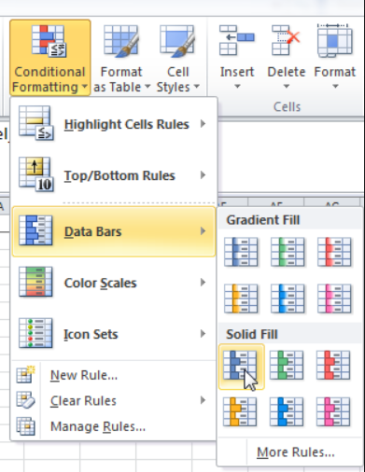
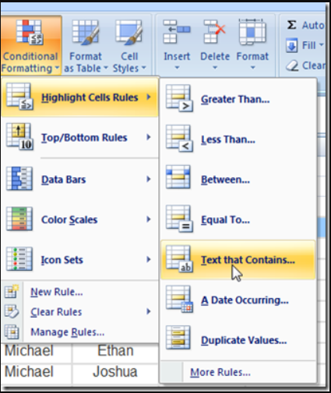
Conditional Formatting
Conditional Formatting is a powerful tool in excel that allows to visually highlight , emphasize or apply specific formatting to cells based on certain conditions.
Conditional formatting is commonly used to emphasize high or low values ,identify duplicates , visualize data distribution and more.
This enhances the visual analysis of a data , making it easier to interpret the data by highlighting important information or trends.

Slide 4
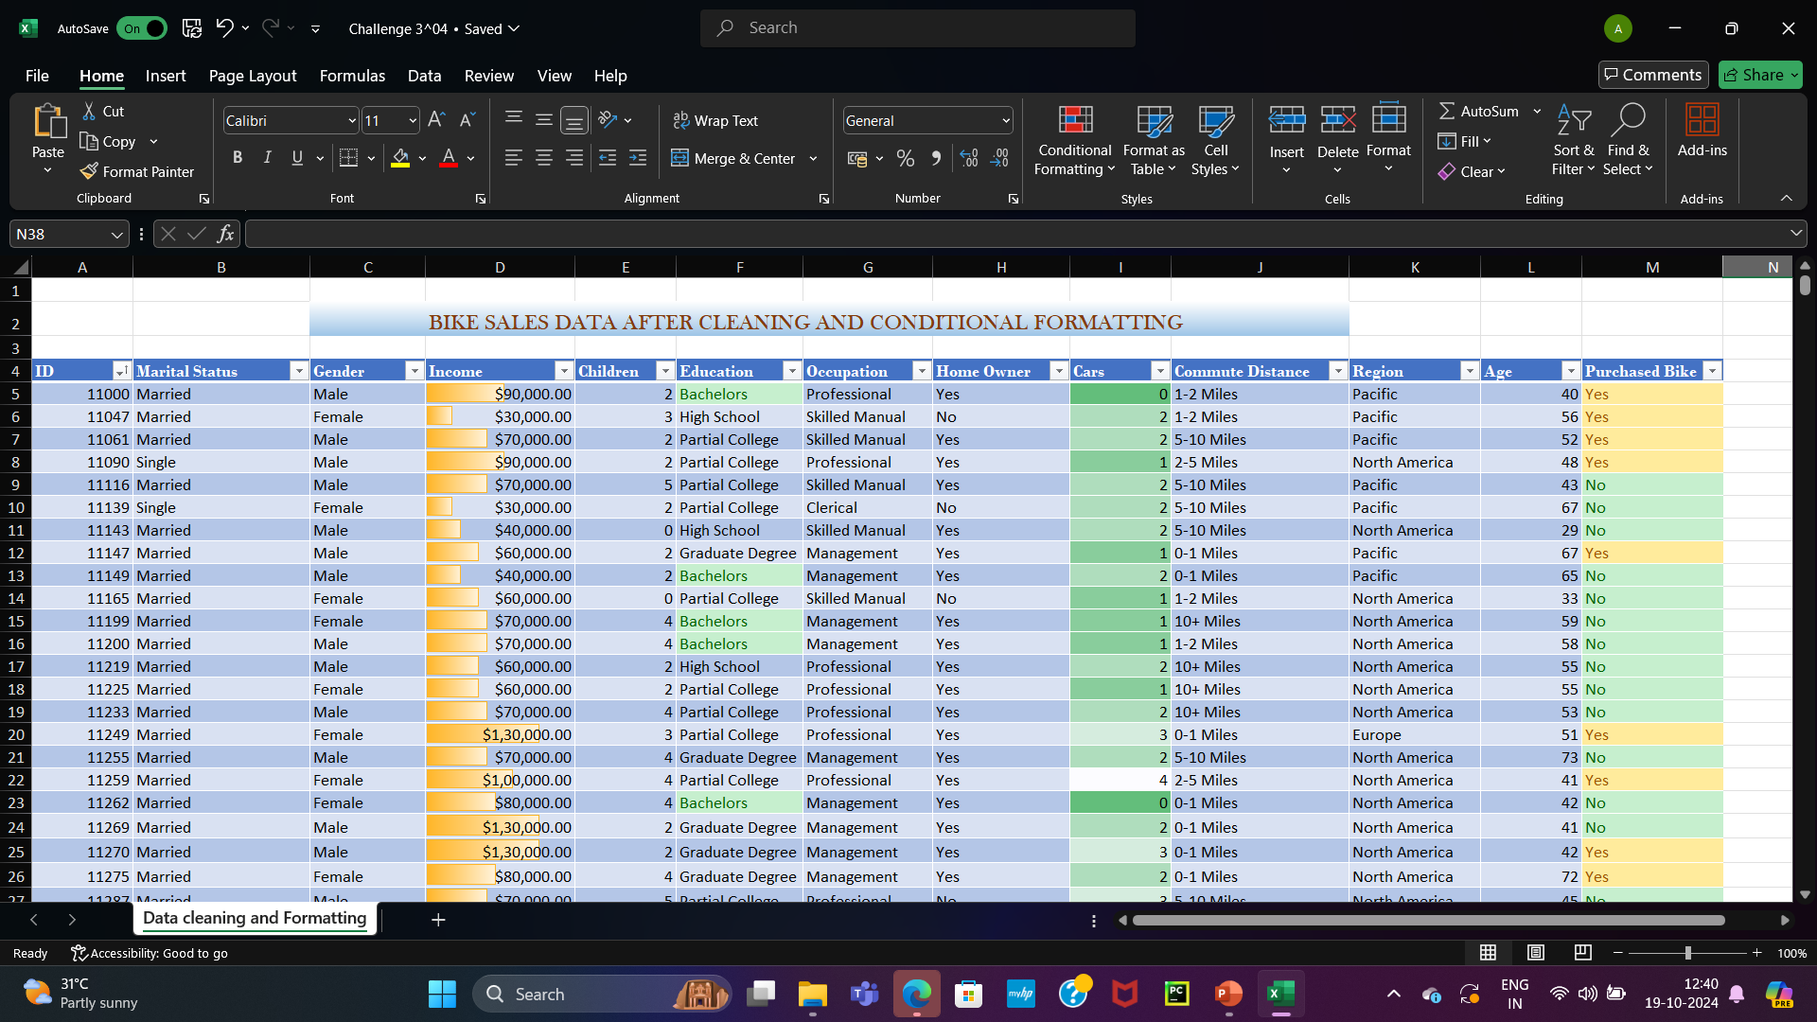
By Data Cleaning Process; Removed Duplicates , Sorted ID In Ascending Order, Changed Data Type Of Income , M&S Changed To Married And Single And Also M&F Changed To Male And Female By Find And Replace By Conditional Formatting; Used Solid Fill Data Bar For Simply analysing the Income Level , Used Highlight Cells Rules To Fill The Cells For Easy Visualization , Used Highlight Cells Rule In Bachelors To Visualize Easily , Used Color Scales For Easy Comparison Of Values.

